Slide 1
PTSD risk calculator
10.1.19

Slide 2
The task
Original data – 1103 subjects, 179 columns
PCL3 strict == 0 is 681
PCL3 strict == 1 is 44

Slide 3
Describe data
Missing data column – 0.5 threshold
Missing data row – 0.9 threshold (None)
Features: 64
Strafiied train test split – 0.15 test

Slide 4
Features

Slide 5
Few features groups
Time dependent features:
Only T1 & T2
Coping mechanimsms
Psychological isssues
- Dot probe
Unifomal features:
Genes
Army
Demographic
others

Slide 6
Time dependent features
Coping mechanimsms:
"active_coping", "planning", "positive_reframing", "acceptance", "humor", "religion", "emotional_support", "instrumental_support", "self_distraction", "denial1, "venting”, "substance_use”,"behavioral_disengagement", "self_blame",

Slide 7
Time dependent features
Psychological isssues:
"state”, "trait", "lot “, “phq", "PCL”

Slide 8
Time dependent features
Dot probe:
"T1Acc1t", "T1Acc1n", "T1bias"

Slide 9
uniform features
Genes :
"HML_5HTT", "HL_MAOA", "HML_NPY“, "HML_FKBP5"

Slide 10
uniform features
Army :
"COMT_Hap1_recode", "COMT_Hap2_recode“, "military_exposure_unit“, "COMT_Hap1_LvsMH"

Slide 11
uniform features
Demographic :
"Ashken_scale", "Sephar_scale", "Unknown“, "age", "highschool_diploma", "Hebrew

Slide 12
uniform features
others :
"dyslexia", "ADHD", "T1ETBE“, "trauma_history8_1“
"ptgi2", "cd_risc1"

Slide 13
Imputation & scaling
Mean imputation for numeric
Mode imputation for categoric
No scaling needed

Slide 14
Feature selection

Slide 15
Feature engineering
Deltas
Interactions
Only Little improved…

Slide 16
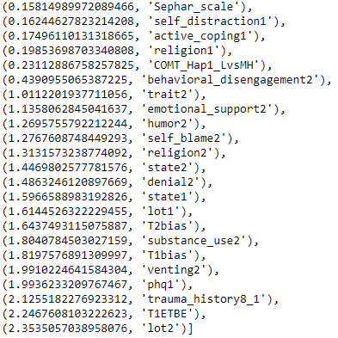
PCA
Our PCA with 0.99 explained variance:

Slide 17

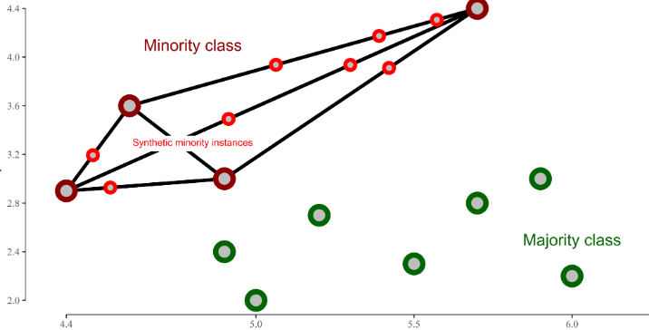

SMOTE: Synthetic Minority Over-sampling Technique

Slide 18
Algorithm evaluation

Slide 19
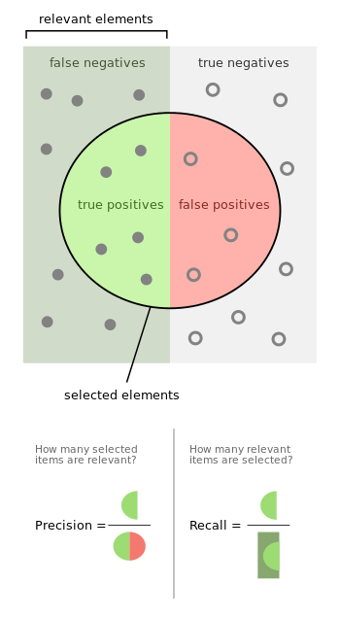

F1 Score

Slide 20
Pipline
Impute missing data
PCA transformation
SMOTE
Get cross validation score
Get training error
Get calibrated probabilities

Slide 21
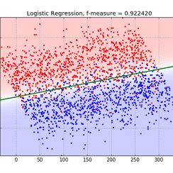

The algorithms
1. Logistic Regression 2. Random Forest

Slide 22


Results logistic regression
Without SMOTE –
With SMOTE –

Slide 23

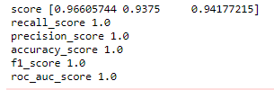
Results Random Forest
With SMOTE –
With PCA before SMOTE

Slide 24
Calibrated probability
LogisticRegression returns well calibrated predictions by default as it directly optimizes log-loss.
RandomForestClassifier histograms show peaks at approximately 0.2 and 0.9 probability, while probabilities close to 0 or 1 are very rare.

Slide 25
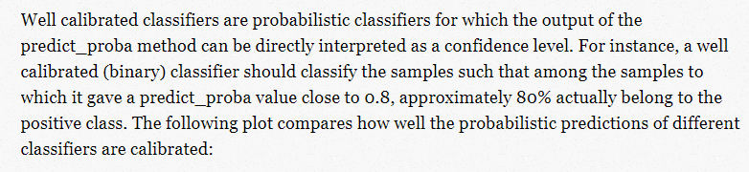
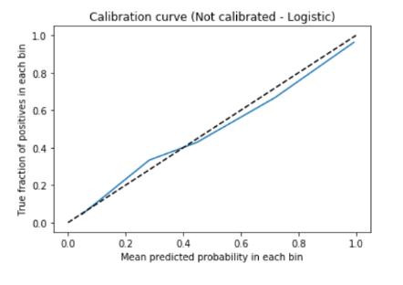
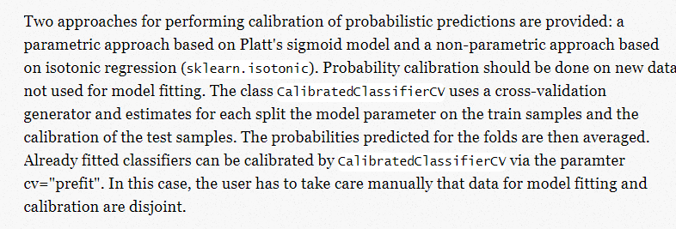
Calibrated probability

Slide 26
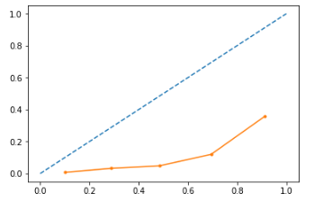
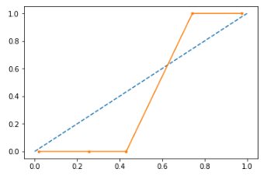
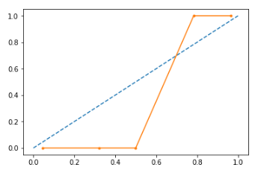
Log reg Calibrated Random Forest
RandomForestClassifier

Slide 27
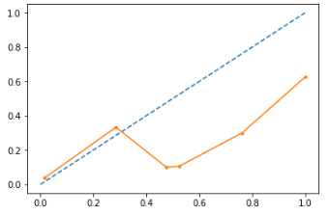
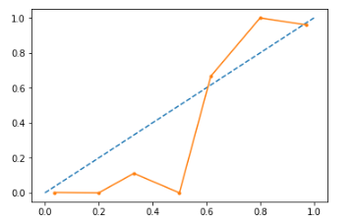
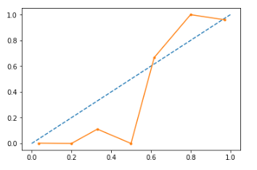
More graphs
RF cv = 5
RF cv= “prefit”
RF sigmoid

Slide 28

We want simple calculator
RF without T2 features
Results:

Slide 29

We want simple calculator
RF with 15 most important PCA features
The features- '['T1ETBE’, 'T1bias’, 'T2bias’, 'state1’, 'state2’, 'trait1’, 'trait2',
'phq2’, 'PCL1’, 'PCL2’, 'cd_risc1’, 'ptgi2’, 'Ashken_scale’, 'Sephar_scale’, 'Unknown']
Results:

Slide 30
What’s now?
Code review
Grid search & other models
Clustering & unsupervised learning

